Slide 1
Machine Failure Prediction Using Logistic Regression
Predicting Machine Failures for Predictive Maintenance

Slide 2
Introduction
This aims to highlight the use of logistic regression for predicting machine failures based on sensor data. The objective is to reduce downtime and enhance operational efficiency by enabling predictive maintenance through timely failure predictions.

Slide 3
Table of contents
Dataset Overview
Exploratory Data Analysis (EDA) Distribution of Machine Failures
Correlation Heatmap
Model Selection
Model Training and Evaluation
Model Evaluation (Confusion Matrix)
Key Insights
Model Limitations
Future Work

Slide 4
Dataset Overview
Source: Sensor data collected from machines. Key Features include footfall, temperature mode, air quality index, ultrasonic sensor readings, current sensor readings, rotational position (RPM), input pressure, temperature, and failure (dependent variable).

Slide 5
Exploratory Data Analysis (EDA)
Checked for missing values. Scaled data using StandardScaler to normalize the feature values. Split data into training (80%) and testing (20%) sets for evaluation.

Slide 6
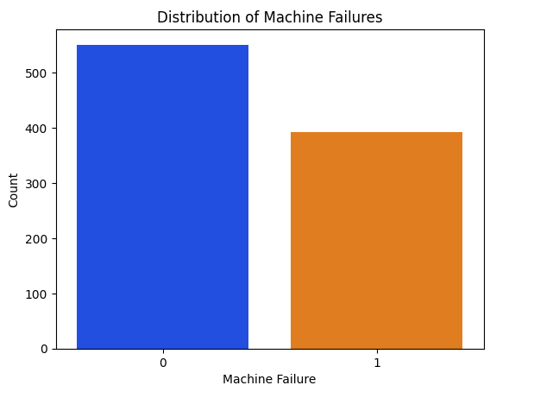
Distribution of Machine Failures
Interpretation: Briefly explain what the plot shows regarding the distribution of machine failures (imbalance between failure (1)and non-failure(0)).

Slide 7
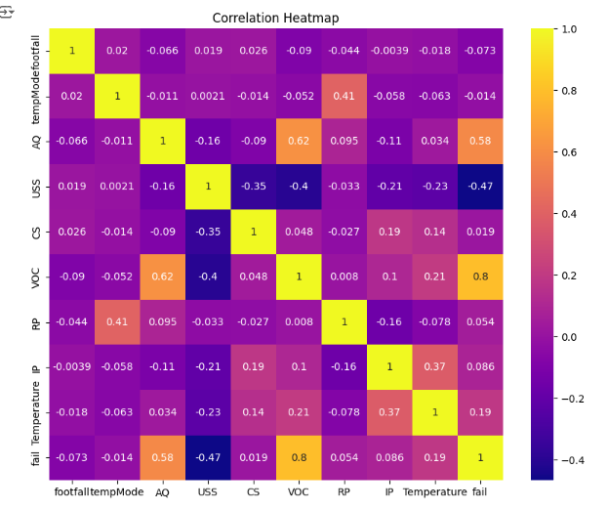
Correlation Heatmap
Performed correlation analysis using a heatmap to identify relationships between features. Identified key features (e.g., temperature, footfall, RPM) that influence machine failure.

Slide 8
Model Selection
Algorithm Used: Logistic Regression, chosen for its simplicity and interpretability. Suitable for binary classification problems like failure prediction. Provides easy-to-interpret output and performs well with linear decision boundaries.

Slide 9
Model Training and Evaluation
Trained the Logistic Regression model using the training dataset. Predicted failure outcomes on the test dataset. Performance Metrics include accuracy (91%), precision (87.8%), recall (91.1%), and a confusion matrix.

Slide 10
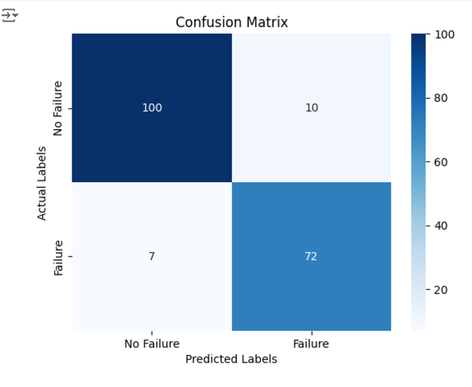
Model Evaluation (Confusion Matrix)
Confusion Matrix: True Positives (72), True Negatives (100), False Positives (10), and False Negatives (7). High precision and recall indicate the model is effective in predicting machine failures, good at identifying failures and avoiding false alarms.

Slide 11
Key Insights
The model can help anticipate machine failures and schedule maintenance to prevent unplanned downtime. Data collected from sensors like temperature, air quality, and RPM proved valuable in predicting failures. Achieved a balance between precision and recall, ensuring reliable failure prediction.

Slide 12
Model Limitations
Performance is dependent on data quality, and imputation of missing values could introduce biases. More advanced feature engineering techniques could enhance model performance. Model may need retraining for different machines or operational environments. Risk of overfitting should be monitored.

Slide 13
Future Work
Explore advanced models like Random Forest for potentially better performance. Incorporate more features like historical maintenance data or time-series data for deeper insights. Integrate the model into real-time predictive maintenance systems for operational environments.

Slide 14
Conclusion
The project demonstrated the ability to predict machine failures using logistic regression and sensor data. The model can significantly impact predictive maintenance, improving operational efficiency and reducing downtime.

Slide 15
Thank you!

